Slide 1
Web apps that sign in users & call APIs
Notes:
In this unit, you’ll learn how to create server-side web apps that allow users to sign in and grant the app permissions to act on the user’s behalf. Once the user has authenticated and granted the app consent to act on their behalf, the web application will use data returned from Microsoft Graph by using the OAuth 2.0 auth code grant flow.

Slide 2

Overview
Single Page Apps (SPAs)
Web Apps that call APIs
OAuth 2.0 authorization code grant flow
Azure AD app registration
MSAL & code configuration
Sign-in & obtain access token
Call APIs
Daemon / Service Apps

Slide 3
Web apps that sign-in users & call APIs
Notes:
In this first section we’ll look at Web apps that sign-in users & call APIs

Slide 4
Web apps that sign-in users & call APIs
Adding authentication enables a web app access to limited profile details
Name, email, unique ID
Users authenticate in a browser
Web app redirects users to Microsoft identity to sign-in
Microsoft identity redirects users back to web app with claims about the user in an Identity token
Web app can also obtain an access token from Microsoft identity to act on the user’s behalf
Notes:
Adding authentication enables your web app to access limited profile information and customize the experience offered to users. Web apps authenticate a user in a web browser. In this scenario, the web application directs the user to sign in to Microsoft identity. Microsoft identity returns a sign-in response through the user’s browser, which contains claims about the user in a identity token.
As a second phase you can also enable your application to call web APIs on behalf of the signed-in user.

Slide 5
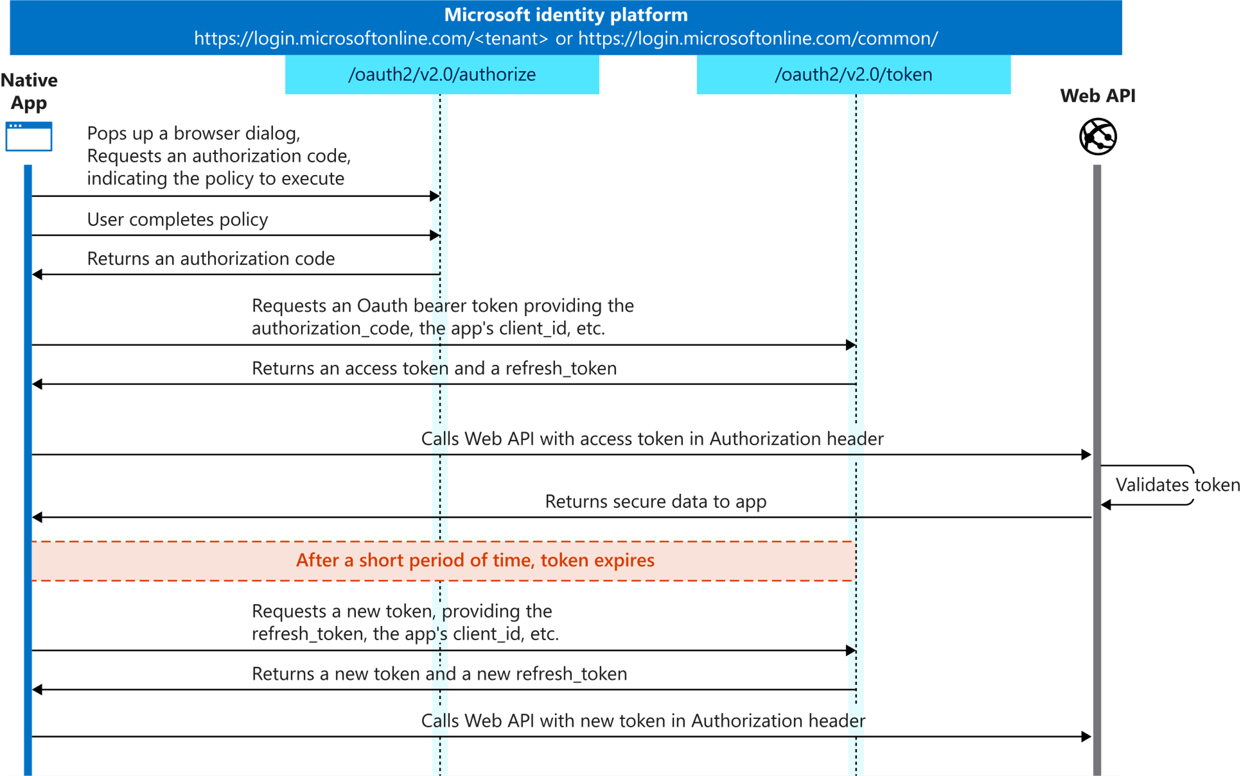
OAuth 2.0 authorization code grant flow
Notes:
The OAuth 2.0 authorization code grant flow is common when websites or custom applications leverage Azure AD as a federated authentication provider. When the application needs a user to sign in, or needs an access token to act on their behalf, it redirects the user over to Azure AD’s authorization endpoint to authenticate. The user signs in using their email and password and in turn Azure AD redirects the user upon a successful sign-in back to a specific URL in the app.
When Azure AD redirects the user back to the web app, it includes an authorization code. The authorization code is an encoded string that only Azure AD can read. The web app takes this authorization code, which is valid for a short time, and includes it in a request to the Azure AD token endpoint.
In addition to the authorization code, the request to the token endpoint includes a `grant_type` parameter that tells the endpoint it's exchanging the authorization code to obtain the access token on your behalf.
A benefit of this grant flow is that the web app never sees your username and password. All authentication happens over on Azure AD and the application just gets the authorization code that’s a result of the sign-in process. This aspect to the auth code grant flow makes it very secure.

Slide 6
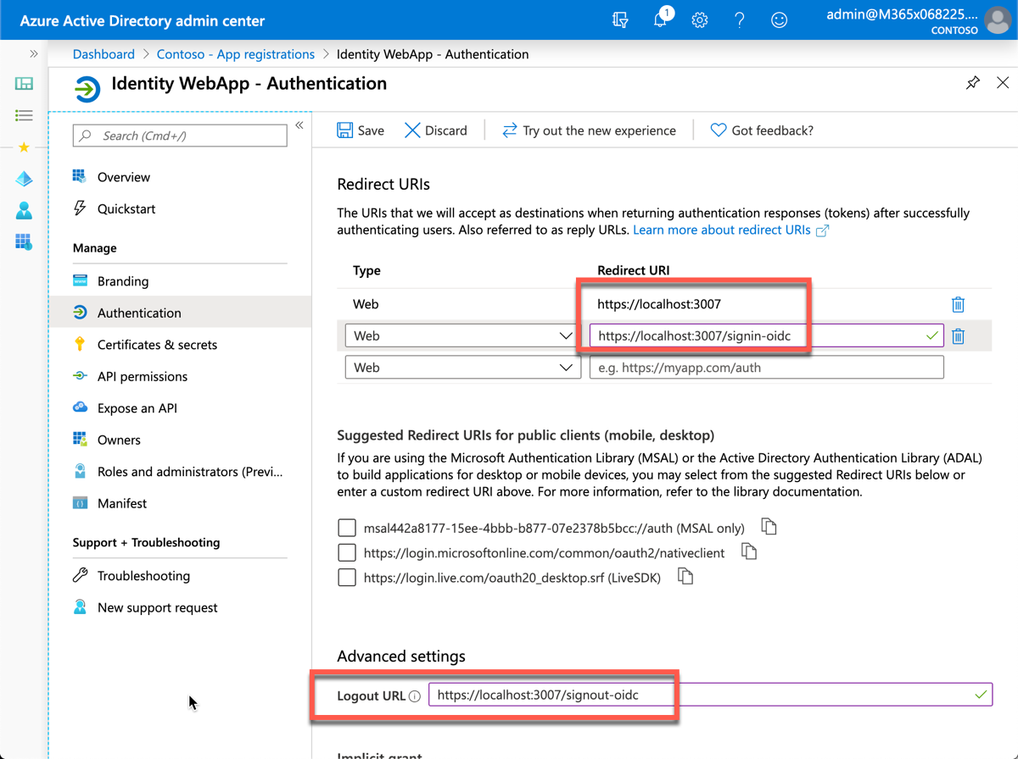
Azure AD app registration
Web apps must have an associated Azure AD app registration to support user sign-in & obtain access token
Ensure Redirect URI & Logout URL are set
Web app also needs a client secret
Used by app to authenticate when exchanging auth code for access token
After creating app, copy 3 values for use in MSAL & code configuration:
Tenant ID
Client ID
Client secret / certificate (production apps)
Notes:
In order for a web app to use Microsoft identity to enable users to authenticate and obtain access tokens for use with services such as Microsoft Graph, you must register a new app with Azure AD. This can be done using the Azure AD admin center https://aad.portal.azure.com.
When registering the app in Azure AD, ensure the redirect URI of the app points to the callback URL of the web app. This URL must match the redirect URL provided by the app when the authentication process is started. The authorization code will be sent to this endpoint, which means you need to configure any authentication libraries and/or middleware to listen on this endpoint to receive the authorization code.
A sign-out URL should also be specified so the authentication libraries and/or middleware deletes any cached tokens or other data that are only needed for signed in users.
The web app will also need a client secret to sign in with Azure AD to exchange the authorization code for an access token.
There are three things you'll need from the Azure AD app registration:
- **Tenant ID**: ID of your Azure AD directory
- **Client ID**: unique auto-generated ID of the app (*this is also referred to as the application ID*)
- **Client secret**: secret you created during app registration
> [!NOTE]
> While a secret key is used here for purposes of simplicity, Microsoft recommends production apps use certificates with the OAuth 2.0 authorization code grant flow.

Slide 7
MSAL .NET Configuration
Configure any middleware and libraries that handle authentication within the application startup
In ASP.NET Core, this is done in the Startup.cs file, specifically the ConfigureServices() method
Configure the Open ID connect middleware to process the ID token:
Set the authority for Azure AD to the Oauth 2.0 Azure AD endpoint for the tenant where the Azure AD app was registered
Request an authorization code & ID token when the user signs in
Associate the user’s name property in ASP.NET to the claim preferred_username returned in the ID token
Notes:
The web app startup process to configure the support for signing-in with Azure AD and obtaining an ID token.
In an ASP.NET Core web application, add code to the `ConfigureServices()` method that will complete the Azure AD configuration by doing the following steps:
- Set the authority for Azure AD to be the OAuth 2.0 Azure AD endpoint
- Request both an authorization code and ID token when the user signs in
- Associate the user's name property in ASP.NET to the **preferred_username** claim returned in the ID token
- Create a callback when the authorization code is received to add all claims from the ID token to the current signed-in user's claims

Slide 8
User Sign-in & acquiring an access token
Sign-in process handled by redirecting user to Azure AD sign-in page
The MSAL .NET SDK uses the appsettings.json to create the sign-in request
Upon successful sign-in, user is redirected back to the web app that can then request an access token
var application = ConfidentialClientApplicationBuilder.Create(appSettings.ClientId)
.WithAuthority(appSettings.Instance + appSettings.TenantId +"/v2.0/")
.WithRedirectUri("https://localhost:5001" + appSettings.CallbackPath)
.WithClientSecret(appSettings.ClientSecret)
.Build();
var accessToken = await application.AcquireTokenSilent(scopes, account).ExecuteAsync();
Notes:
The sign-in process is handled by redirecting the user to the Azure AD sign-in page. This is set by default for you when you create a new ASP.NET Core web application.
The sign-in process uses the values from the **appsettings.json** file and the configuration defined in the previous setup to create the Azure AD URL to send the user to. This URL specifies things like the Azure AD application's ID, the tenant ID, and the scopes required by the web application.
When a user signs-in to Azure AD and is redirected back to the web application, the web app can use the MSAL.NET library to obtain an access token:
The account is retrieved from the currently signed-in user. The token can then be used to call a secured endpoint.

Slide 9
Calling APIs – Microsoft Graph
Last part of the process is to submit a request to the authenticated endpoint with the access token
When working with ASP.NET, it’s preferred to create an instance of the authenticated client in Startup.cs
Add it as a singleton to ASP.NET’s dependency injection
public UserController(GraphServiceClient graphServiceClient) {
_graphServiceClient = graphServiceClient;
}
public async Task<IActionResult> Index() {
var userRequest = this._graphServiceClient.Me.Request()
var userResponse = await this._graphServiceClient.SendAsync(request);
return View(userResponse)
}
Notes:
The last part of the process is to use the access code in a request to a secured endpoint.
One way to do this is to create an instance of the Microsoft Graph client and add it as a singleton to ASP.NET Core's dependency injection system:
The instance of the service can then be used from a controller within the web application:

Slide 10
Demo

Slide 11
Thank you.

